Slide 1
Prognozowanie, ale nie POGODY
Wojciech Borawski, Michał Broch, Karolina Karszna, Milena Pawlak

Slide 2
Źródło danych
Kaggle | https://www.kaggle.com/uciml/electric-power-consumption-data-set
Used and alternative resources | An assortment of graphic resources that are suitable for use in this presentation
Thanks slide | You must keep it so that proper credits for our design are given
Więcej informacji Freepik | Flaticon |

Slide 3
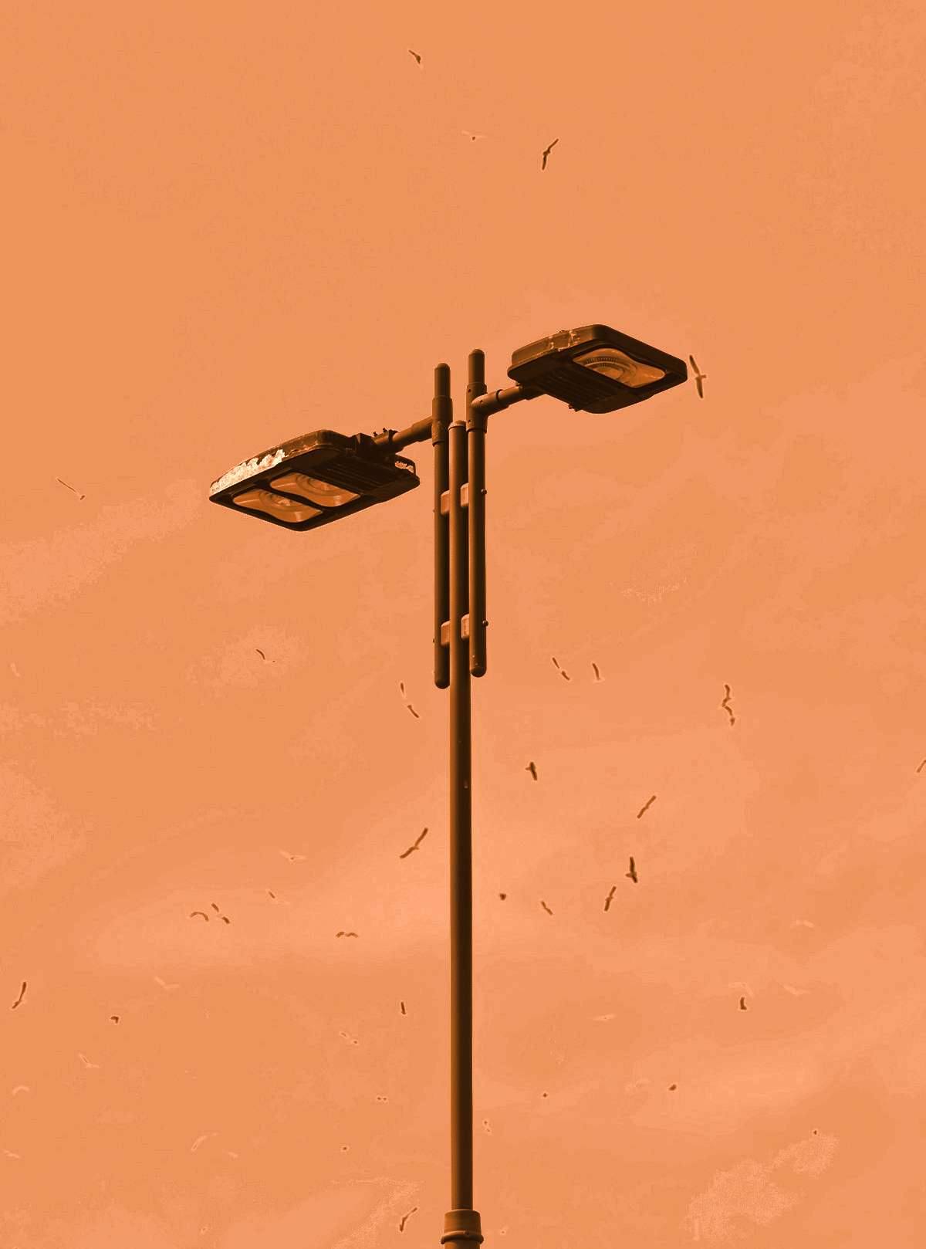
Cel projektu
Prognozowanie zapotrzebowania na energię elektryczną w mieszkaniu
Interesariusz: elektrownia starająca się ustalić kiedy możliwe będzie przeprowadzenie napraw z uwagi na niższe zużycie energii

Slide 4
2 075 259
Liczba rekordów w całym Datasecie

Slide 5
333,000
9h 55m 23s
386,000 km
The Sun’s mass compared to Earth’s
Jupiter's rotation period
Distance between Earth and the Moon

Slide 6
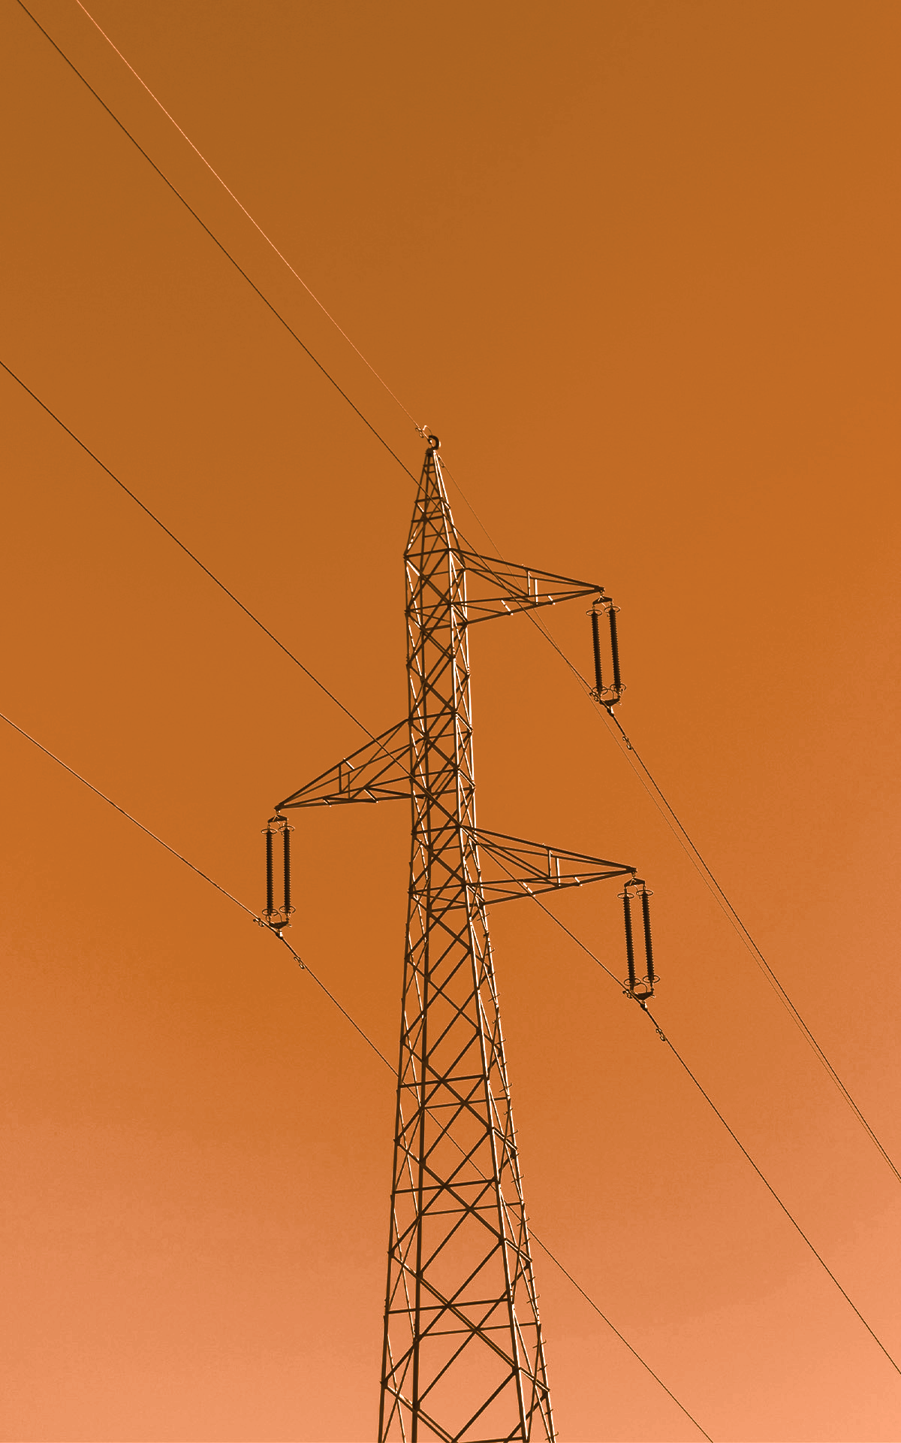
Przygotowanie danych
W ramach analizy zapotrzebowania na energię elektryczną w mieszkaniach:
Przeprowadziliśmy analizę zapotrzebowania energii w latach 2006-2010
Ujednoliciliśmy dane poprzez zsumowanie ich do pełnych godzin pomiarowych
Wykorzystaliśmy model Prophet do przygotowania prognozy

Slide 7
Analiza poboru energii elektrycznej
01
02
03
04
Dane
ogólne
Prognoza 2011
Wnioski
Proponowane
daty napraw

Slide 8
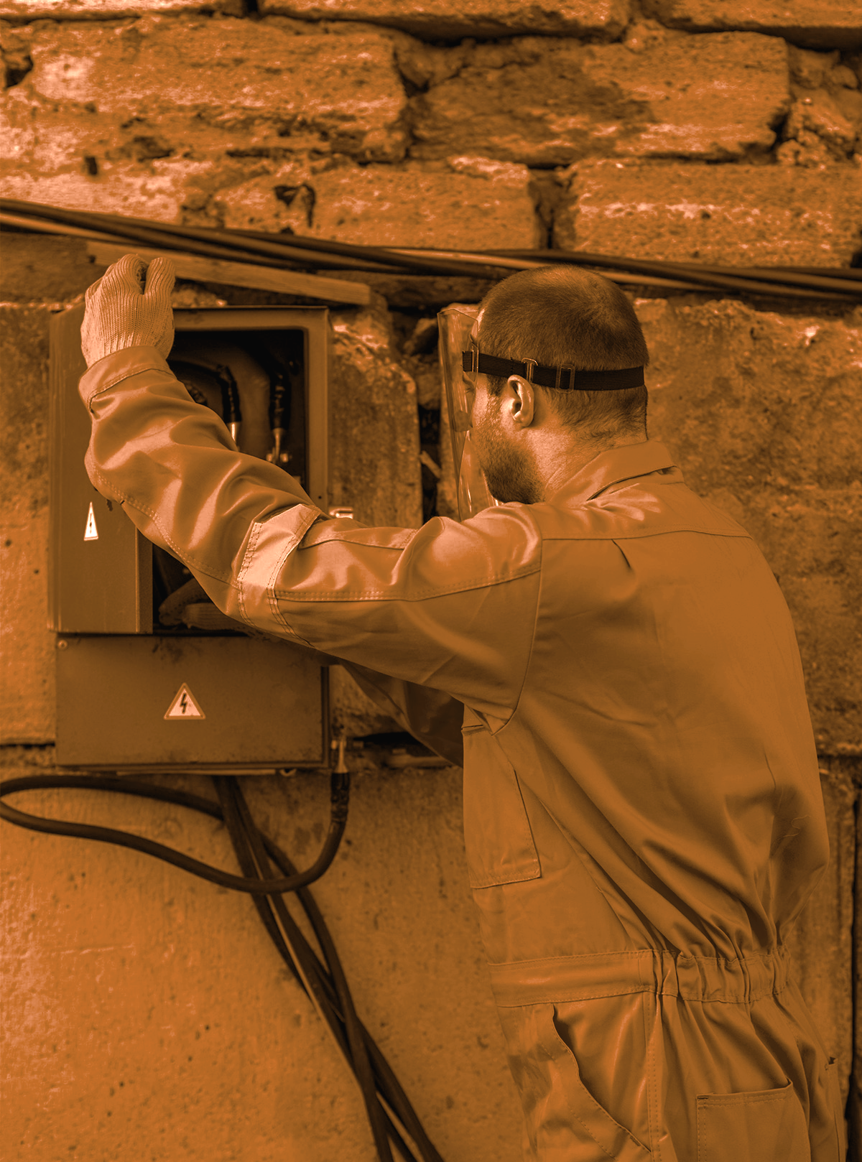
01
Dane ogólne

Slide 9
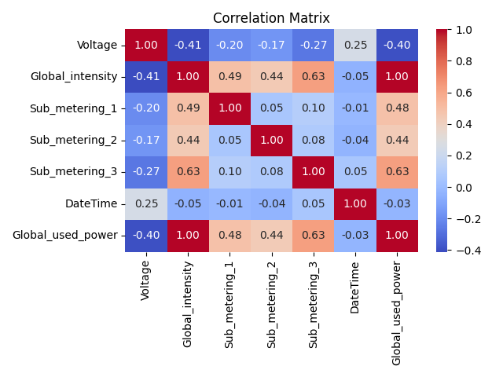

Slide 10
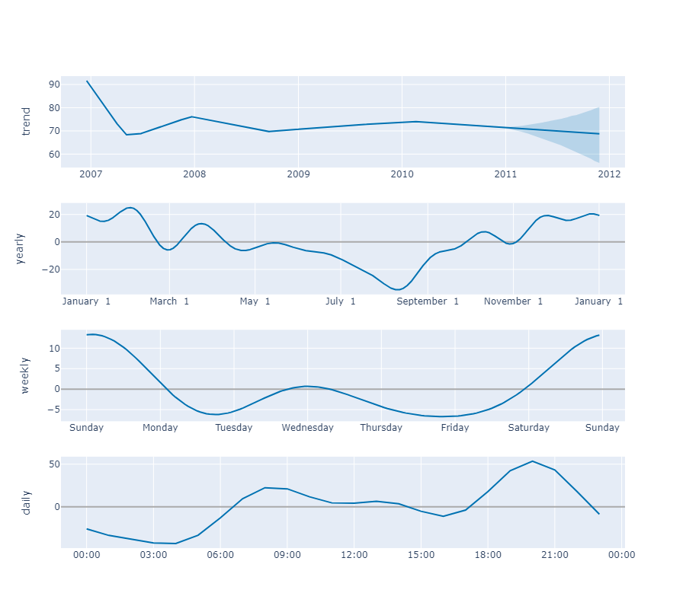

Slide 11
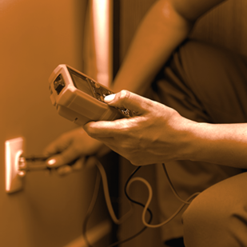
02
Prognoza 2011

Slide 12
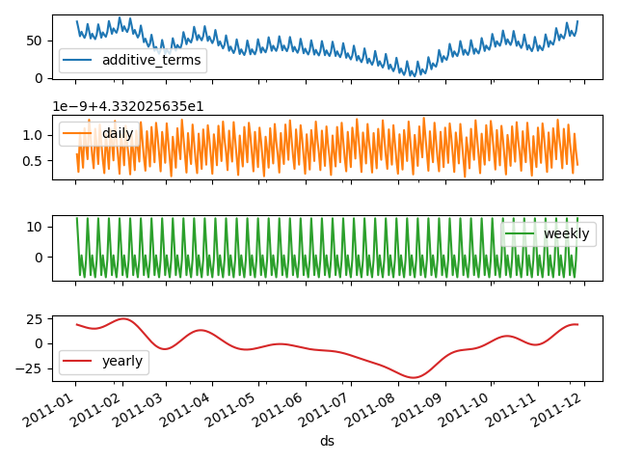
Prognoza zużycia energii w 2011

Slide 13
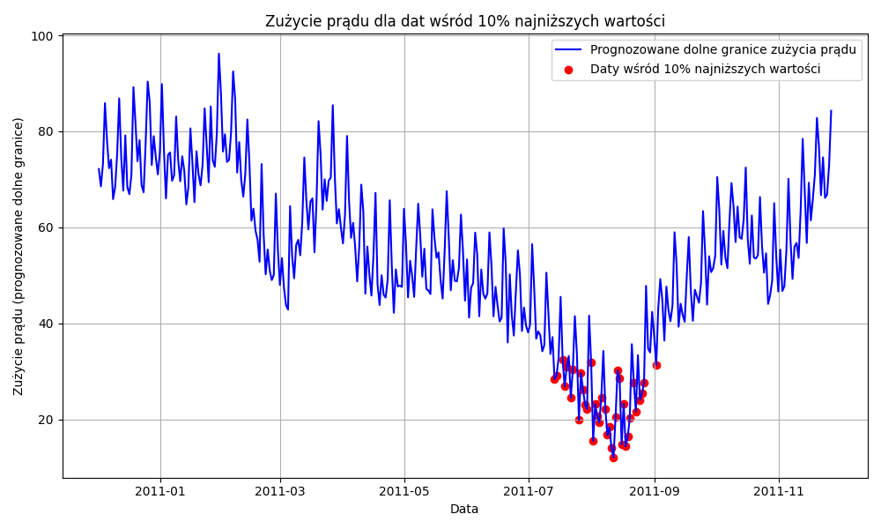
Zużycie energii w 2011
Prognoza
Na podstawie danych historycznych najniższe zużycie energii prognozujemy w lipcu i sierpniu

Slide 14
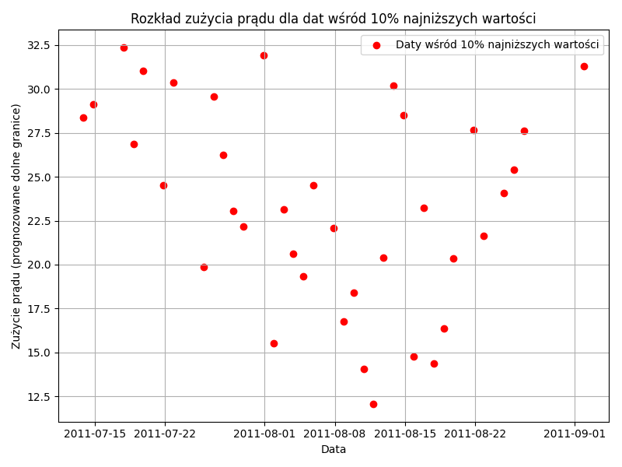
Rozkład zużycia energii w 2011
Wyłączenia
Możliwe terminy napraw zależne od dat wśród najniższych wartości w lipcu i sierpniu

Slide 15
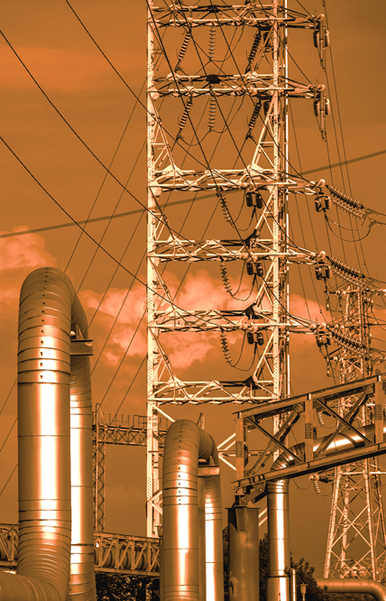
03
Proponowane daty napraw

Slide 16
LIPIEC
PN | WT | ŚR | CZW | PT | SB | NDZ
 |  |  |  | 1 | 2 | 3
4 | 5 | 6 | 7 | 8 | 9 | 10
11 | 12 | 13 | 14 | 15 | 16 | 17
18 | 19 | 20 | 21 | 22 | 23 | 24
25 | 26 | 27 | 28 | 29 | 30 | 31

Slide 17
SIERPIEŃ-WRZESIEŃ
PN | WT | ŚR | CZW | PT | SB | NDZ
1 | 2 | 3 | 4 | 5 | 6 | 7
8 | 9 | 10 | 11 | 12 | 13 | 14
15 | 16 | 17 | 18 | 19 | 20 | 21
22 | 23 | 24 | 25 | 26 | 27 | 28
29 | 30 | 31 | 1 | 2 | 3 | 4

Slide 18
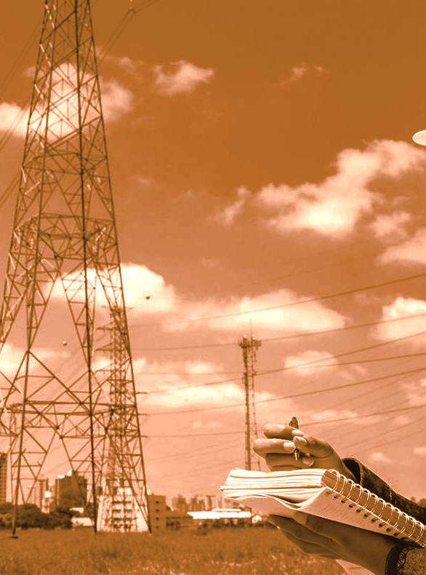
04
Wnioski

Slide 19
Two ideas
Mercury
Venus
Mercury is the closest planet to the Sun and the smallest one in the Solar System—it’s only a bit larger than the Moon. This planet’s name has nothing to do with the liquid metal, since Mercury was named after the Roman messenger god
Venus has a beautiful name and is the second planet from the Sun. It’s terribly hot—even hotter than Mercury—and its atmosphere is extremely poisonous. It’s the second-brightest natural object in the night sky after the Moon

Slide 20
Three ideas
Jupiter
Venus
Saturn
Jupiter is a gas giant and the biggest planet in the Solar System. It's the fourth-brightest object in the night sky and it was named after the Roman god of the skies
Venus has a beautiful name and is the second planet from the Sun. It’s terribly hot and its atmosphere is poisonous. It’s the second-brightest natural object in the night sky
Saturn is a gas giant and has several rings. This planet is composed mostly of hydrogen and helium. It’s the sixth planet from the Sun and was named after a Roman god

Slide 21
Four ideas
Mars
Venus
Despite being red, Mars is actually a cold place. It's full of iron oxide dust, which gives the planet its reddish cast, and it’s made of basalt
Venus has a beautiful name and is the second planet from the Sun. It’s terribly hot, even hotter than Mercury. It has a toxic atmosphere
Jupiter
Saturn
Jupiter is a gas giant and the biggest planet in the Solar System. It's the fourth-brightest object in the night sky. It was named after a Roman god
Saturn is a gas giant and has several rings. It's composed mostly of hydrogen and helium. It’s the sixth planet from the Sun

Slide 22
—Someone Famous
“This is a quote, words full of wisdom that someone important said and that can inspire the reader”

Slide 23
Dziękujemy!
Dodatkowe pytania prosimy kierować na:
datageeks@gmail.com | +48 456 789 123 | datageeks.com

Slide 24
Fonts & colors used
This presentation has been made using the following fonts:
Goldman
(https://fonts.google.com/specimen/Goldman)
Mulish
(https://fonts.google.com/specimen/Mulish)
#1d1d1b
#d1630f
#e5e5e5
#cccccc
#b4b4b4

